Slide 1
Pertness System

Slide 2
Testing sent data with Arduino Nano device
1000 Datas
- Write in 83 min to SD card
- Sent to RSP Pi in 19 min
- No lost data
10.000 Datas
- Write in 13.5 hours to SD card
- Sent to RSP Pi in 1h 28 min
- No lost data

Slide 3
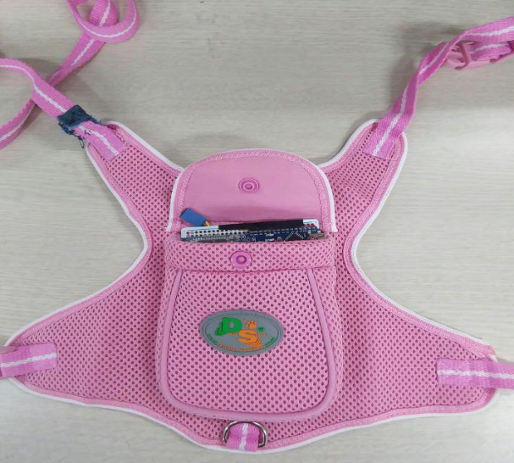
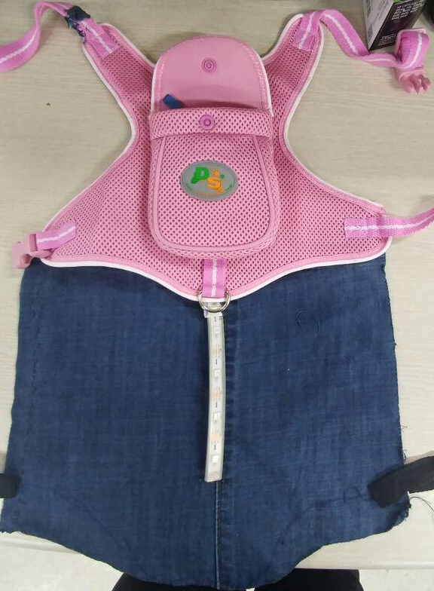
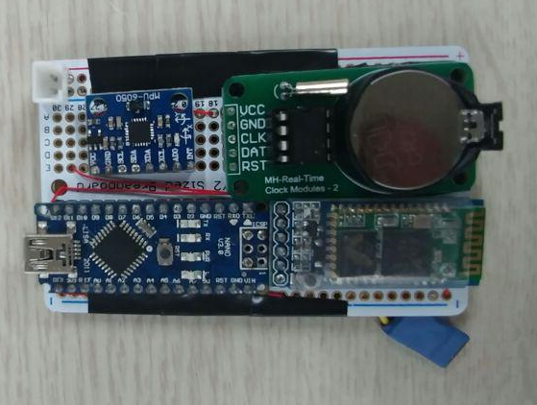
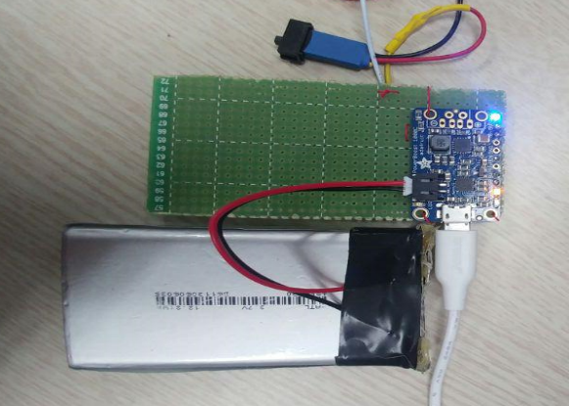
Making Smart Pet Costume Design
New fixable Arduino Nano device
Pet costume for testing
Fixing for Pololu - LEDs
Showing behavior status
High capacity battery (12.2 Wh) 3.7 V

